Slide 1



Economics of natural hazards
Veronique Florec and Morteza Chalak
School of Agricultural and Resource Economics
University of Western Australia

Slide 2
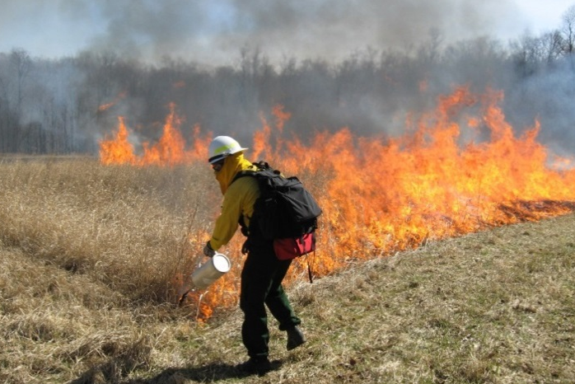
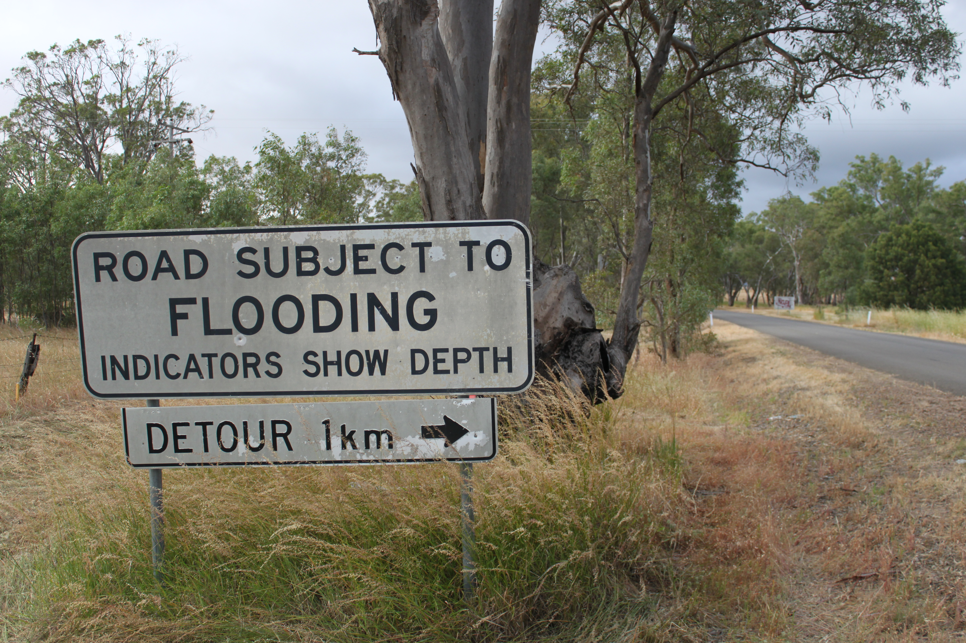
Our project
Help deliver value for money from public investments in natural hazard management

Slide 3

Our project
Key research questions:
How should emergency budgets be set, recognising the variability of need?

Slide 4

Our project
Key research questions:
With limited budgets, which strategies for managing natural hazards offer the best value for money?
  How do we prioritise investments between different locations and different hazards?

Slide 5
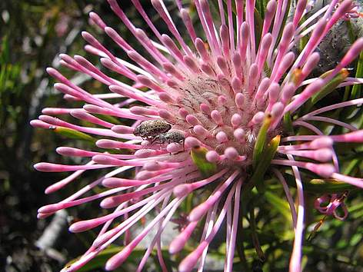

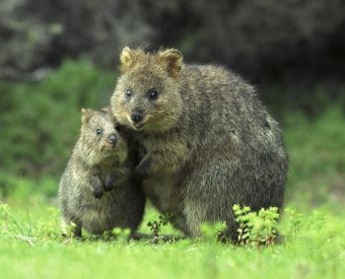
Our project
Key research questions:
How can we value the social and environmental benefits of management?
  What difference does it make to take social and environmental benefits into account in economic analyses of natural hazard mitigation options?

Slide 6
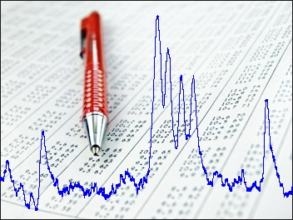
Our project
Key research questions:
What are the requirements for sound economic analysis of natural hazard management?

Slide 7
Our project
The University of Western Australia
Started in January 2015
2 components
  Valuation tool for intangible goods and services
  Integrated economic assessment of natural hazard mitigation options

Slide 8
Our project
Case studies
  South Australia
  Western Australia
PhD student
  PhD thesis: “Economic analysis of prescribed burning in the south-west of Western Australia”
  Me ☺

Slide 9
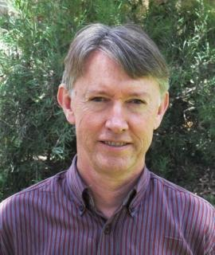
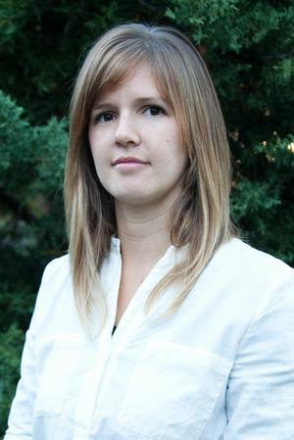
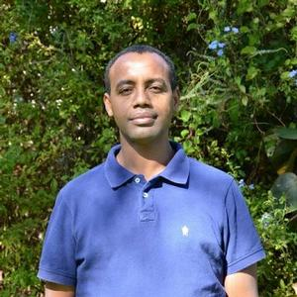
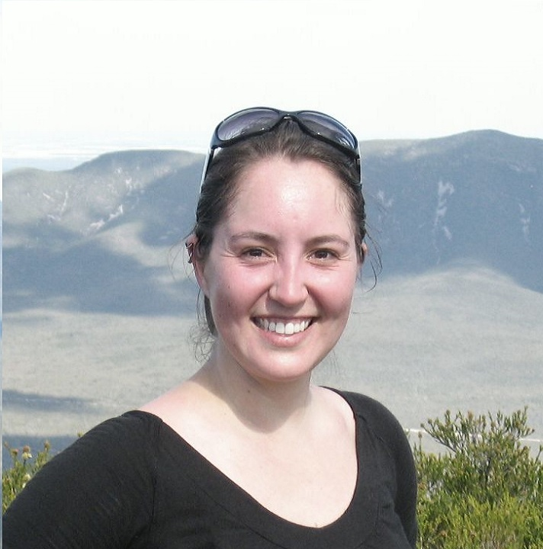
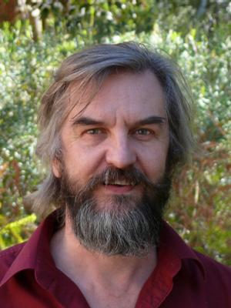
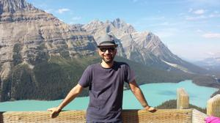
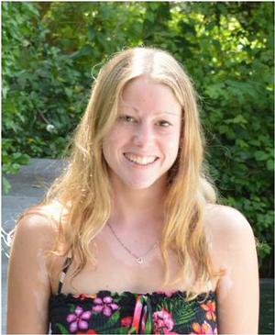
Our research team @ UWA
Atakelty Hailu
Fiona Gibson
David Pannell
Veronique Florec
Morteza Chalak
Michael Burton
Abbie Rogers

Slide 10

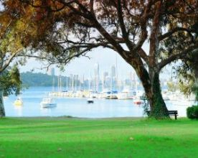
Our offices

Slide 11
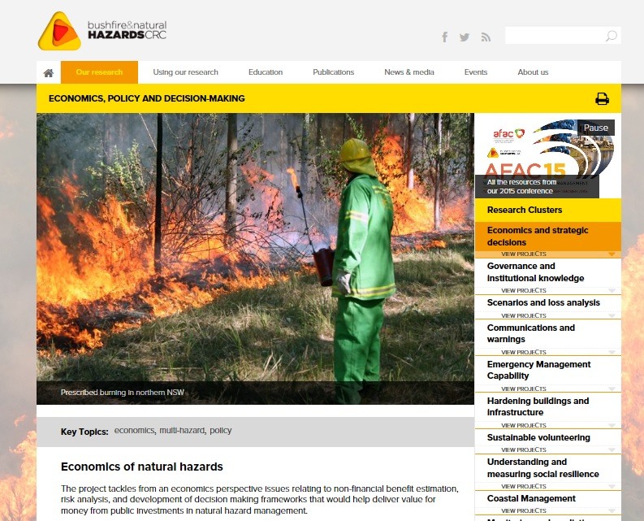
Visit the BNHCRC website

Slide 12
The economics of natural hazards
What does it involve?
VALUES
SCALE
HAZARD
POLICY
Tangible
Intangible
Local
Regional
State level
National
Single hazard
Multiple hazards
Regulation
Education
Incentives

Slide 13
The economics of natural hazards
What does it involve?
VALUES
SCALE
HAZARD
POLICY
Tangible
Intangible
Local
Regional
State level
National
Single hazard
Multiple hazards
Regulation
Education
Incentives

Slide 14
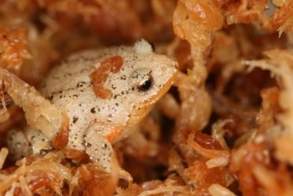
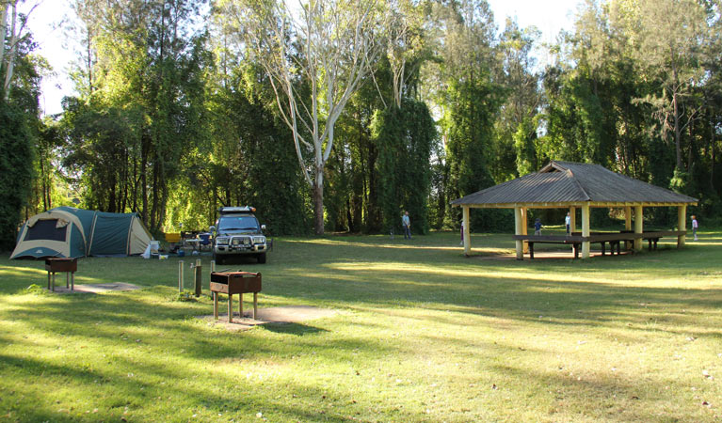
Non-market (intangible) values
Things that people care about, that are not traded in formal markets
  e.g. biodiversity, risk of ill health, amenity
Values can be large: important to include them in decision making
Notes:
Non-market, or intangible, values are things people care about, that are not traded in formal markets. For example one can’t buy improvement in biodiversity, because there is no market for this.
Because these non-market values can be quite large it’s important that they be included in decision making
Decision making frameworks that are often used by engineers, economists, and governments, like CBA, compare costs and benefits, in dollars, to produce an estimate on the value for money of projects. Data on the market costs/benefits is easy. To get data on the non-market costs/benefits requires some translation of these values to people in dollar terms.
Economists have developed methods to quantify NMVs in dollar terms. For example, the choices people make over NMVs in proxy markets. The difference in value of a property next to vs far away from an inner city lake provides some information on the value on amenity.
Or we can survey people and directly ask their WTP for an improvement in biodiversity at location X, via a hypothetical market.

Slide 15


Non-market (intangible) values
For like/ like comparison with market (tangible) values, these non-market values (NMVs) can be quantified in dollars
Economists have developed methods to do this
  Behaviour in proxy markets e.g. property sales price
  Stated “willingness to pay” in hypothetical markets
Notes:
Non-market, or intangible, values are things people care about, that are not traded in formal markets. For example one can’t buy improvement in biodiversity, because there is no market for this.
Because these non-market values can be quite large it’s important that they be included in decision making
Decision making frameworks that are often used by engineers, economists, and governments, like CBA, compare costs and benefits, in dollars, to produce an estimate on the value for money of projects. Data on the market costs/benefits is easy. To get data on the non-market costs/benefits requires some translation of these values to people in dollar terms.
Economists have developed methods to quantify NMVs in dollar terms. For example, the choices people make over NMVs in proxy markets. The difference in value of a property next to vs far away from an inner city lake provides some information on the value on amenity.
Or we can survey people and directly ask their WTP for an improvement in biodiversity at location X, via a hypothetical market.

Slide 16
Non-market (intangible) values in decision making
Assessing the NMVs from natural hazard management poses issues:
  Original studies are costly
  Many existing studies on the types of values impacted, but not many are measured in the context of natural hazards
  Transferring value estimates from other studies to use in a new management decision/context requires expert guidance
Notes:
Although these NMV methods are well established and the data obtained robust, there are some considerations for their application to natural hazard management.
To do an original study to identify the dollar value of a particular management action is expensive.
We could use estimates from existing studies, but there’s lots of them – many may not be appropriate to use in a natural hazard management context.
If we did agree on a suitable study, using the dollar value in a CBA still requires some degree of expert guidance.

Slide 17
Non-market values project: outputs
3 workshops with leading economists to work through issues
2 working papers that capture these discussions
Several meetings with end users on their information needs for NMVs
Developed a framework to assist end users in identifying relevant NMVs for different hazards, and management options
Notes:
To work through many of these issues, we’ve has 3 workshops wit leading economists that have resulted in 2 working papers.
Several meetings with end users have been had to identify their needs from this project.
The first output from these meetings and the expert discussions is a framework that assists in the identification of the NMVs impacted by natural hazard management.

Slide 18
Non-market values project: in progress
We are working on a database of dollar value estimates for non-market impacts of natural hazards
Supporting document with:
  Introduction to NMV theory and methods
  Instructions on how to use the value estimates in decision making
  Discussion on key behavioural insights from NMV studies
Worked examples from applying the database, could include:
  Approach to include the Value of a Statistical Life in the University of Adelaide Multi-hazard Decision Support System
  Comparison of mitigation options with market and NMV impacts with WA SEMC
  Damage assessment of Samson Flat fire with SA DEWNR
Notes:
The work in progress from the end user meetings and expert discussions is a data base of dollar estimates for the relevant NMVs. The data base will provide end users with an easily accessible source of credible NMV estimates that they can use in CBA. The discussions highlighted credible NMV information as a clear requirement for end users.
End users were also keen to been provided with supporting information to the database:
Intro to NMV theory and methods
Instructions on how to use the dollar estimates in CBA
Key insights for non-CBA decision making e.g. the value of a statistical life varies with demographics and cause of death
Finally, the end users and Holger Maiers group have ask if we could provide worked examples for using NMVs in various decision making tools. Some possible case studies are:
Approach to include the Value of a Statistical Life in the University of Adelaide Multi-hazard Decision Support System
Comparison of mitigation options with market and NMV impacts with WA SEMC
Damage assessment of Samson Flat fire with SA DEWNR

Slide 19

I hope you are Not going crazy?

Slide 20

Stay calm
Be present, be cool!

Slide 21
Ooooooooohhhhhmmmmmmm

Slide 22

5 – 7 minutes

Slide 23
The economics of natural hazards
What does it involve?
VALUES
SCALE
HAZARD
POLICY
Tangible
Intangible
Local
Regional
State level
National
Single hazard
Multiple hazards
Regulation
Education
Incentives

Slide 24
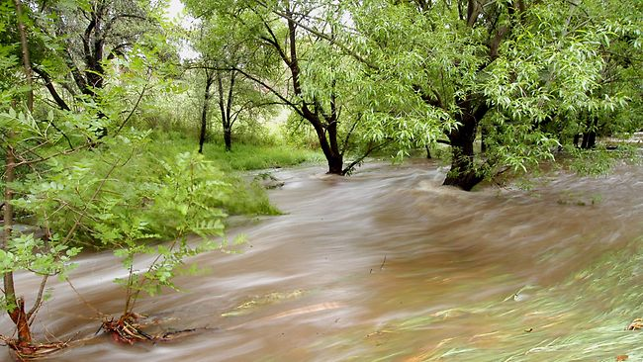
Economics of flood mitigation options
Brown Hill Creek and Keswick catchments are two high flood risk catchments in Adelaide.
Flood damages in the area would be significant.
They have been the subject of recent planning exercises aimed at improving flood protection.

Slide 25

Economics of flood mitigation options
Several proposals for flood mitigation investments have been presented and public consultations reveal that proposed strategies have widely different effects on segments of the communities in the suburbs and therefore attract different reactions.

Slide 26
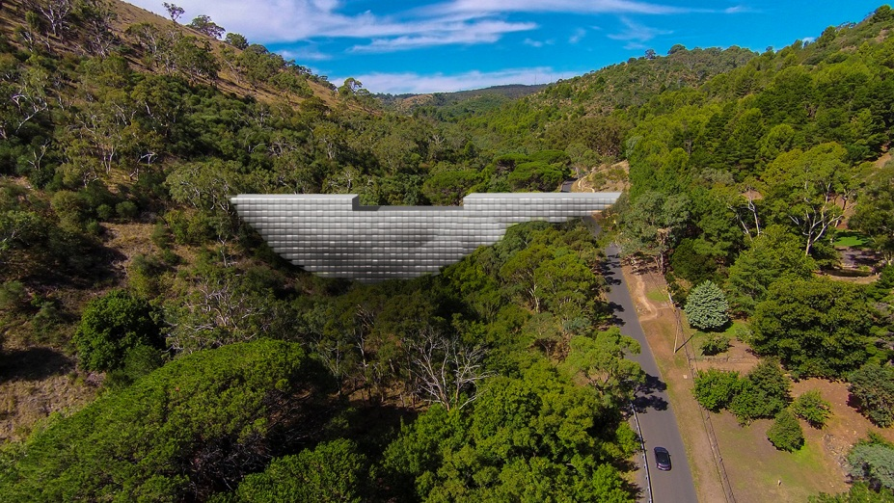
Economics of flood mitigation options
Mitigation options:
Option B1 Detention dam on Brown Hill Creek Recreation Park
Option B2 Detention dam on Ellisons Gully

Slide 27
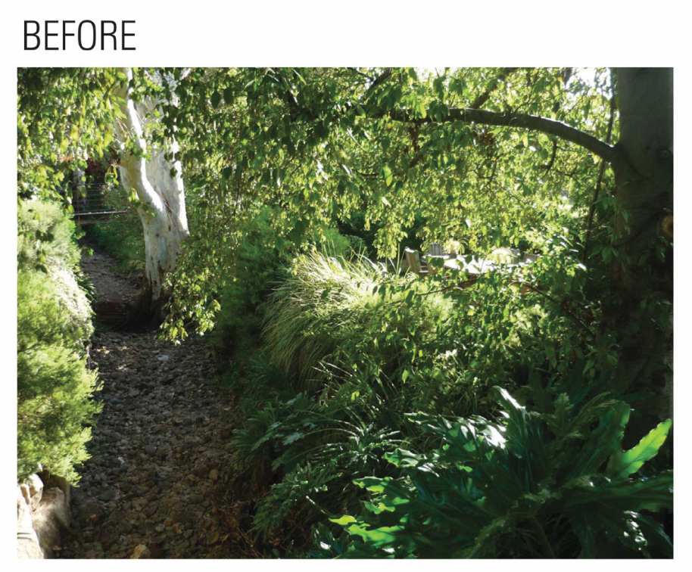
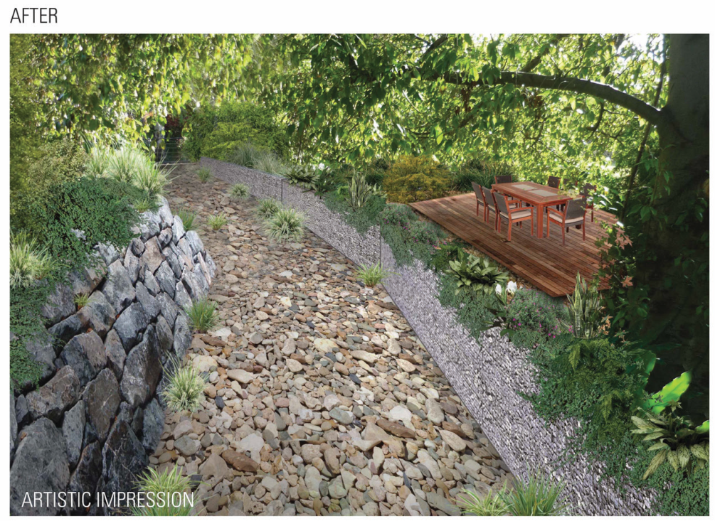
Economics of flood mitigation options
Option D Creek capacity upgrade

Slide 28
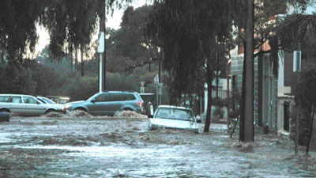
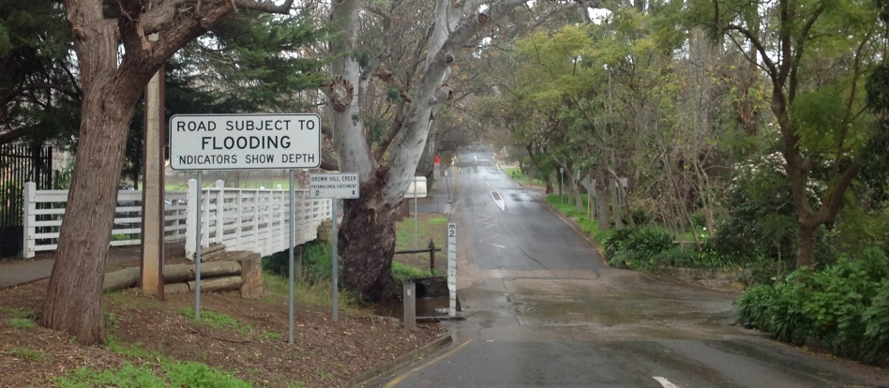
Economics of flood mitigation options
Analysis to-date has focused primarily on the tangible costs and benefits of the structural works.

Slide 29
Economics of flood mitigation options
What if we included intangible values?

Slide 30
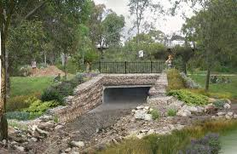
Economics of flood mitigation options
This analysis improves upon the scope of previous studies by incorporating intangible costs.

Slide 32
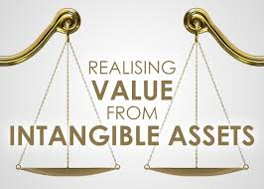
Economics of flood mitigation options
This report presents the case for the inclusion of intangible values, as well as a preliminary set of estimates of the economic damages for the base case and three selected mitigation options.

Slide 33
Economics of flood mitigation options
The inclusion of intangible values is shown to have significant effects on flood damage estimates and the benefits of future mitigation works.

Slide 34
Economics of flood mitigation options
Finalise intangible cost estimates
Estimate benefit : cost ratios
Undertake sensitivity analysis
Seek feedback from end users
Draw recommendations on flood mitigation options

Slide 35
Some results from my PhD
Economic analysis of prescribed burning in the south-west of Western Australia
Economic model
Wildfire simulator (AUSTRALIS)

Slide 36
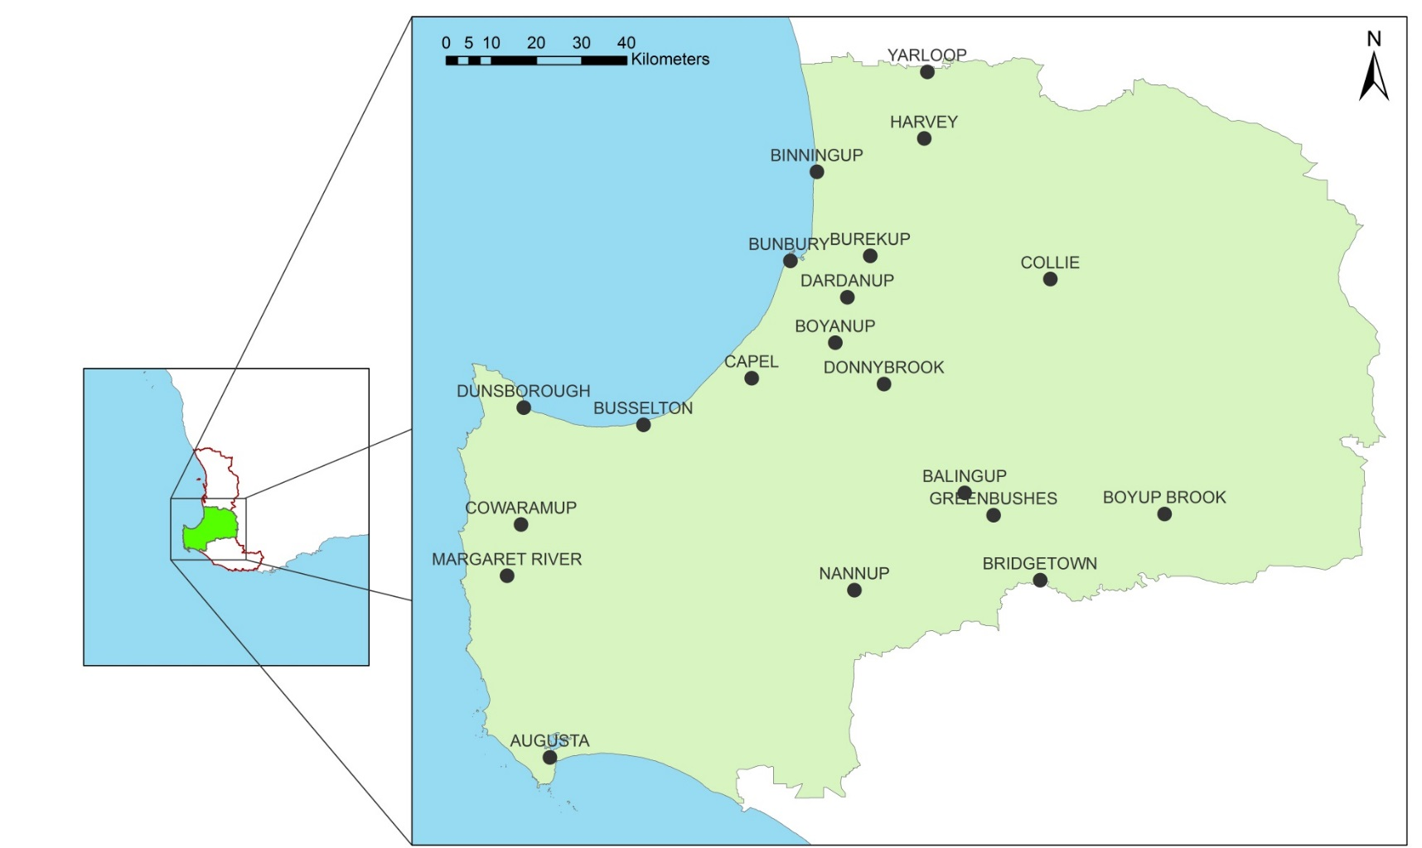
Some results from my PhD
Case study area

Slide 37
Some results from my PhD

Slide 38
Some results from my PhD
On average, for long-term investments 1 dollar generates between $23 and $63 benefits
If ≤ 5% PB, average damages represent between 75% and 80% of the total sum
If ≥ 10%, average damages are between 35% and 60%
On average, damages and management costs are relatively similar if ≥ 10% PB

Slide 39
Some results from my PhD
Major Catastrophic
0%
5%
10%
Major
Catastrophic
15%
20%

Slide 40
Some results from my PhD
The application of prescribed burning reduces the annual probability of catastrophic and major fire seasons in the South West forest region.
No prescribed burning
  catastrophic fire season approximately every 6 years
  major fire season approximately every 7 years
Prescribed burning rate of 5%
  catastrophic approximately every 33 years
  major approximately every 5 years
Prescribed burning rate of 10%
  catastrophic approximately every 200 years
  major approximately every 50 years

Slide 41
Some results from my PhD
To increase the interval of years between catastrophic fire seasons by one year, it is necessary to invest between AU$15,000 and AU$95,000 dollars in prescribed burning
The risk can never be entirely eliminated and even if the optimal prescribed‑burning rate is applied, relatively costly fire seasons may still occur
The prescribed burning rate that achieves the highest reduction in average wildfire area does not necessarily correspond to the rate that minimises the sum of management costs and damages
The current spatial distribution of the treatments generates benefits from the protection of assets located far away from the treatments

Slide 42
Thank you

Slide 43
Get in touch
veronique.florec@uwa.edu.au
morteza.chalak@uwa.edu.au
fiona.gibson@uwa.edu.au
abbie.rogers@uwa.edu.au
atakelty.hailu@uwa.edu.au

