Slide 1
Seismic Assessment and Design Philosophy of Reinforced Concrete Walls in Australia
Ryan D. Hoult
Supervisors: A/Prof Helen M. Goldsworthy
Dr Elisa Lumantarna

Slide 2
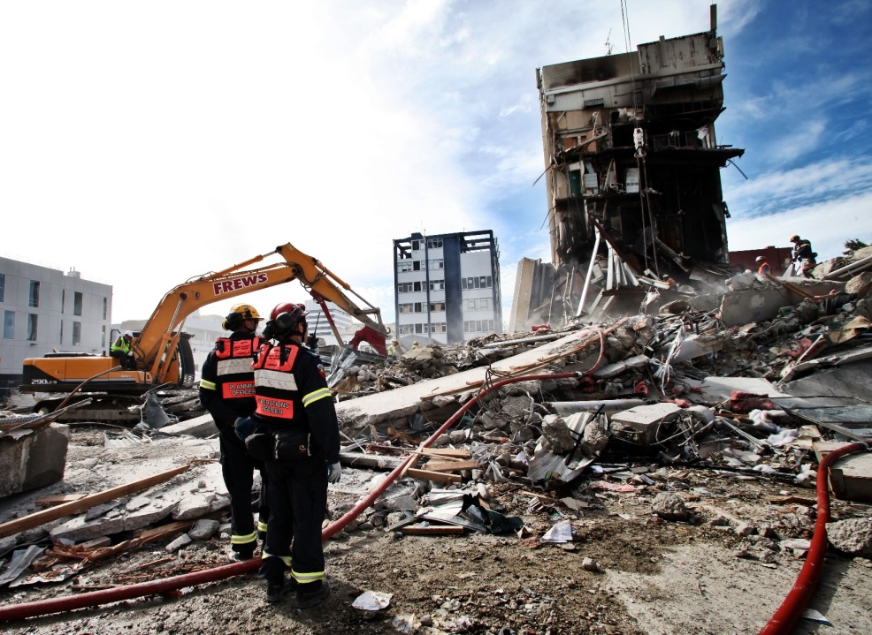
Motivation
I want to improve the performance of reinforced concrete wall and core buildings in Australia…
…by recommending cost effective detailing requirements…
…because the current detailing requirements have created a non-ductile building stock in Australia that is potentially vulnerable to a rare earthquake event.

Slide 3
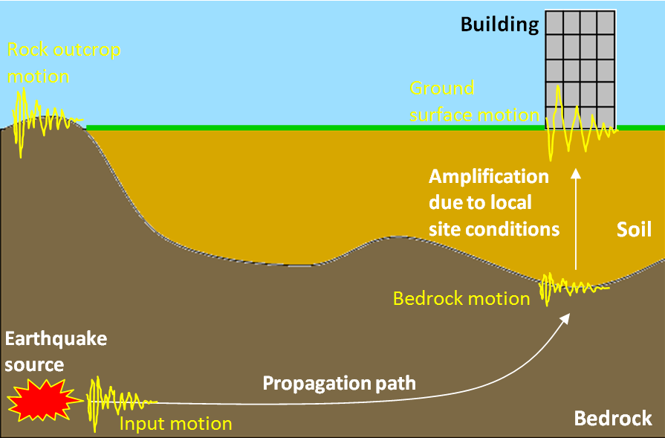
Research
Demand
Earthquake Attenuation in Australia
Revision of Seismic Hazard Values
Soil Amplification
Capacity
R/C Wall and Core Buildings
Rectangular and C-shape
Flexural
Shear
Torsion

Slide 4
Research
Demand
Earthquake Attenuation in Australia
Revision of Seismic Hazard Values
Soil Amplification
Capacity
R/C Wall and Core Buildings
Rectangular and C-shape
Flexural
Shear
Torsion

Slide 5
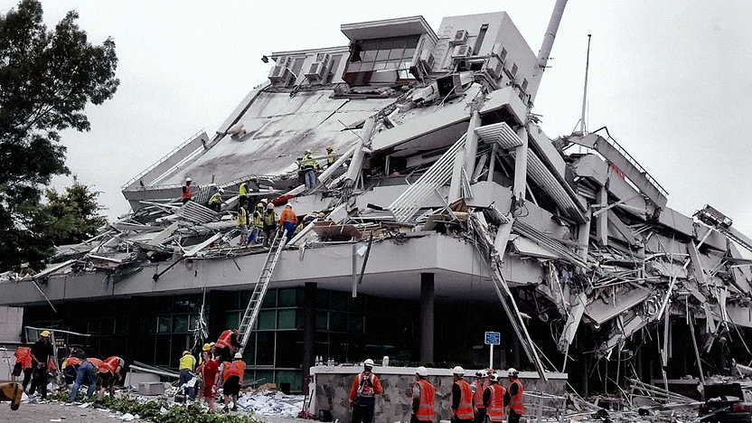
Motivation
Pyne Gould Building
…It was unlikely that sufficient tension could have been transmitted to initiate a secondary crack in the concrete…
(CERC, 2012)

Slide 6
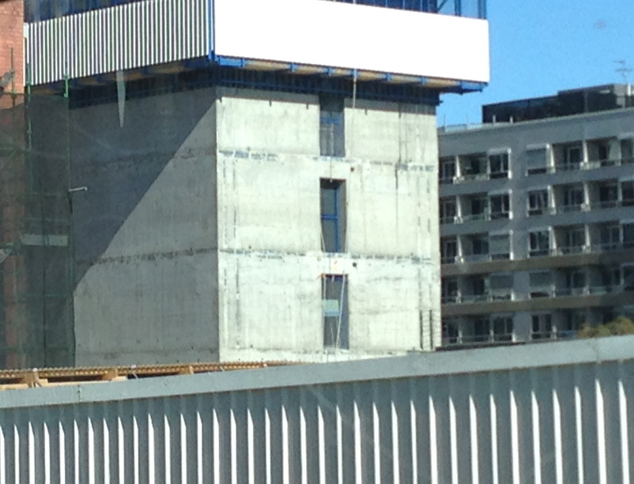
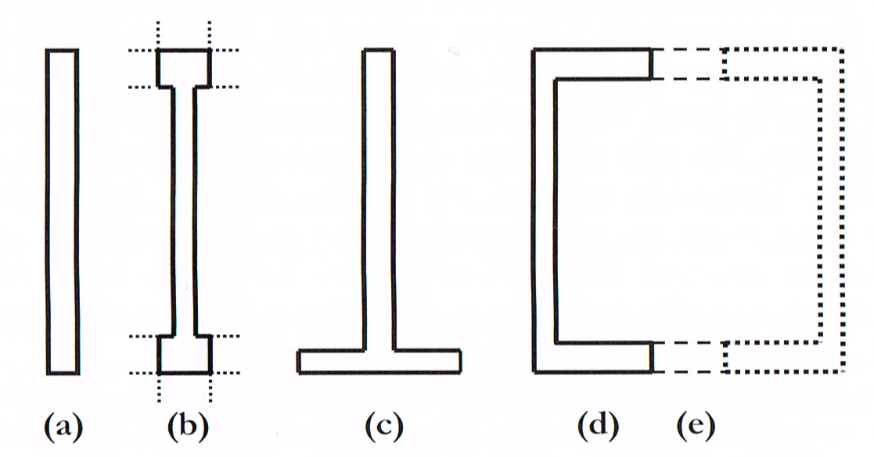
Structural Capacity
RC Walls and Cores
Literature Review: Albidah et al. (2013), Goldsworthy & Gibson (2012), Gurley (2011), Henry (2013 ), Priestley et al. (2007),
Wibowo et al. (2013)
Abundant throughout building stock of Australia
Low-Rise, Mid-Rise, High-Rise
Considered to be “non-ductile” with requirements of AS3600 (2009)

Slide 7
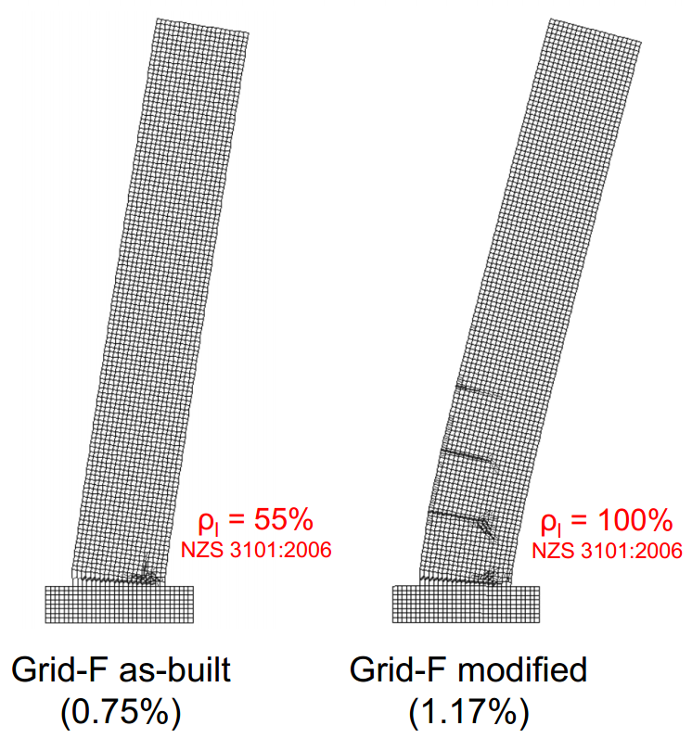
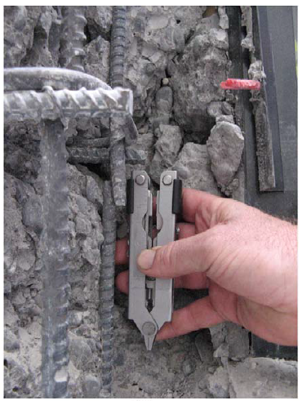
Structural Capacity
Lightly reinforced
Little to no confinement
No “capacity design” principles
Non-ductile
ρ_{wv.min} = 0.15%
Sritharan et al. (2014)

Slide 8
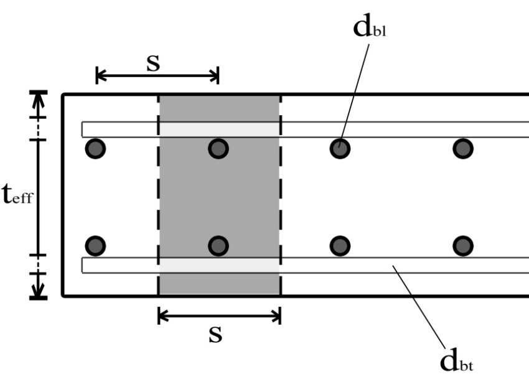
Structural Capacity
Secondary Cracking
if M_{cr} > M_{u}
Stress developed in the concrete
if f’_{ct.fl} > σ_{crack}
$$σ_{crack}=\frac{T}{A_{eff}}$$

Slide 9
Structural Capacity
Secondary Cracking
$$ρ_{wv.min}=\frac{0.54\sqrt{κf_{c}^{′}}}{f_{u}}$$

Slide 10
Structural Capacity
Secondary Cracking
$$ρ_{wv.min}=\frac{0.54\sqrt{κf_{c}^{′}}}{f_{u}}$$

Slide 11
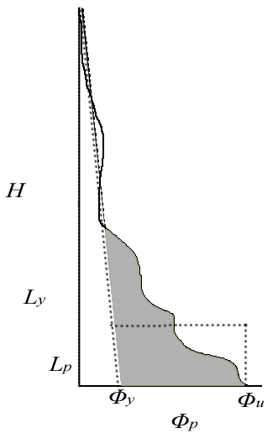
Structural Capacity
Equivalent Plastic Hinge Length
Equations of displacement capacity:
$$∆_{i}= ∆_{y}+ ∆_{p}=\frac{ε_{y}H_{i}^{2}}{l_{w}}\left(1−\frac{H_{i}}{3H_{n}}\right)+θ_{p}H_{i}$$
$$θ_{p}=(∅_{ls}−∅_{y})L_{p}$$
Equivalent Plastic Hinge Length:
$$θ_{e}=\frac{1}{2}\int_{0}^{H}{∅_{y}}dx$$
$$θ_{p}= \int_{0}^{L_{y}}{\left|∅\left(x\right)−∅_{y}(x)\right| dx}$$
$$θ_{p}= ∅_{p}L_{p}$$
$$L_{p}=\frac{θ_{p}}{∅_{p}}=\frac{θ_{p}}{∅_{u}−∅_{y}}=\frac{1}{∅_{u}−∅_{y}}\int_{0}^{L_{y}}{\left|∅\left(x\right)−∅_{y}\right|}$$

Slide 12
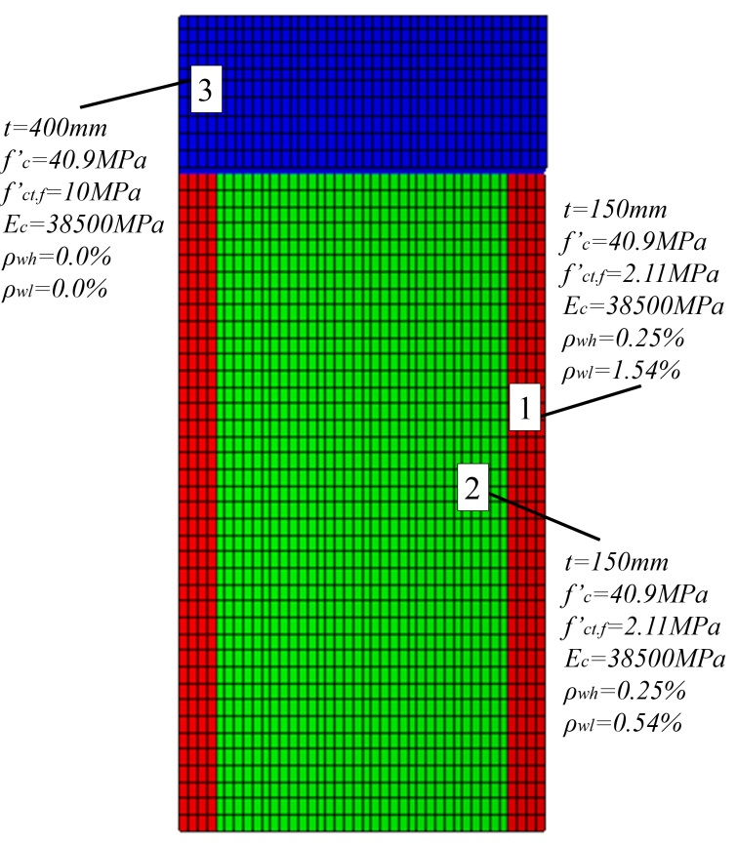
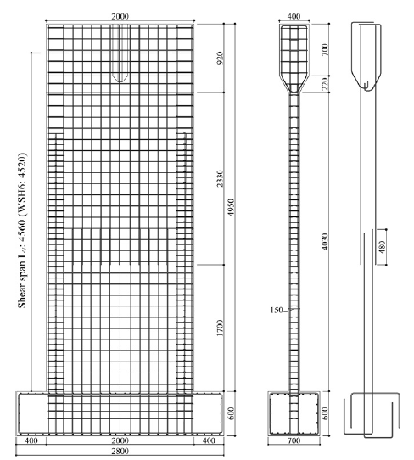
Structural Capacity
VecTor2 Validation
Dazio et al. (1999) and Dazio et al. (2009)
WSH4

Slide 13
Structural Capacity
VecTor2 Validation
Dazio et al. (1999) and Dazio et al. (2009)
WSH4

Slide 14
Structural Capacity
Wall Analyses
Wall No. | L_{w} (m) | t (m) | a | H_{e} (m) | ALR (%) | P (kN) | ρ_{wv} (%) | ρ_{wh} (%)
1 | 7 | 0.2 | 3 | 21.0 | 2.5 | 2100 | 0.19-1.0 | 0.34
2 | 7 | 0.2 | 3 | 21.0 | 7.5 | 6300 | 0.19-1.0 | 0.34
3 | 7 | 0.2 | 5 | 35.0 | 5.0 | 4200 | 0.19-1.0 | 0.34

Slide 15
Structural Capacity
Wall No. 1
Wall No. | L_{w} (m) | t (m) | a | H_{e} (m) | ALR (%) | P (kN) | ρ_{wv} (%) | ρ_{wh} (%)
1 | 7 | 0.2 | 3 | 21.0 | 2.5 | 2100 | 0.19-1.0 | 0.34

Slide 16
Structural Capacity
Wall No. 2
Wall No. | L_{w} (m) | t (m) | a | H_{e} (m) | ALR (%) | P (kN) | ρ_{wv} (%) | ρ_{wh} (%)
1 | 7 | 0.2 | 3 | 21.0 | 7.5 | 6300 | 0.19-1.0 | 0.34

Slide 17
Structural Capacity
Wall No. 3
Wall No. | L_{w} (m) | t (m) | a | H_{e} (m) | ALR (%) | P (kN) | ρ_{wv} (%) | ρ_{wh} (%)
1 | 7 | 0.2 | 5 | 35.0 | 5.0 | 4200 | 0.19-1.0 | 0.34

Slide 18
Structural Capacity
Wall No. 3
Wall No. | L_{w} (m) | t (m) | a | H_{e} (m) | ALR (%) | P (kN) | ρ_{wv} (%) | ρ_{wh} (%)
1 | 7 | 0.2 | 5 | 35.0 | 5.0 | 4200 | 0.19-1.0 | 0.34
0.70%
(b) 0.75%

Slide 19
Structural Capacity
Force-Displacement

Slide 20
© Copyright The University of Melbourne 2009
Notes:
Thank you

